Slide 1
Law and the American Family
Chapter 30
by Jim Brendlinger

Slide 2
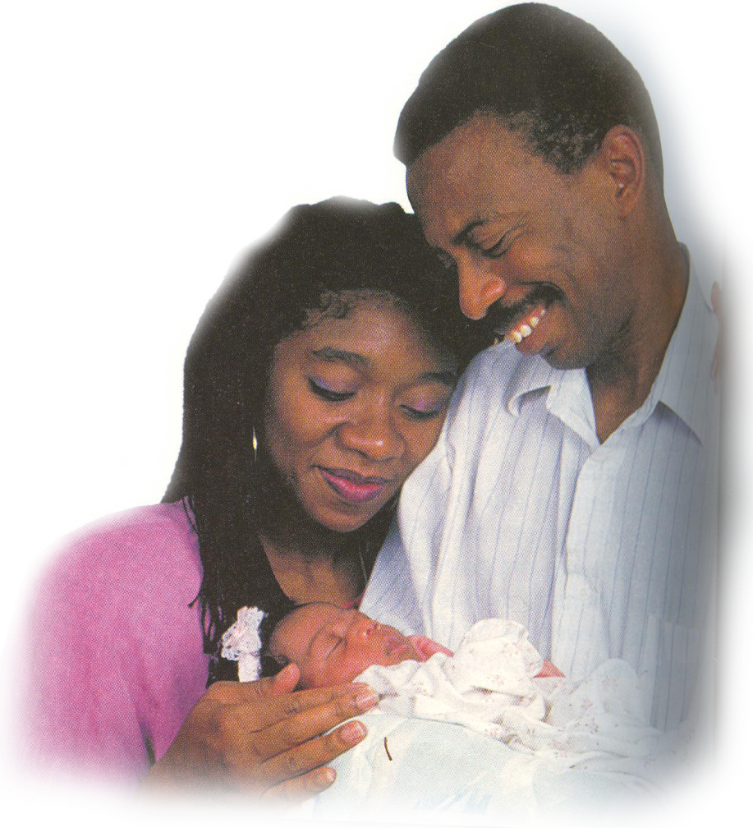
Law from birth to death
At birth:
Social Security Number
Birth Certificate issued by the state
Immunization shots required
Schooling required, or proof
of homeschooling

Slide 3
Responsibilities of parents
Parents are entitled to tax deductions for each dependant child
Must provide basic necessities
The Family and Medical Leave Act: allows employees time off from work to care for new babies or sick relatives
Law also governs permissible parental discipline, adoption, alimony, child care, custody, divorce, and support.

Slide 4
A will
… a document that explains how a person wants his or her property distributed after death
State laws determine who receives your estate if you die without a will, generally a portion goes to your spouse, remainder may go to children, parents, grandchildren, or siblings.
You cannot legally make a will until you reach 18 or 21, depending on the state.
Yet, some states allow persons as young as 14 to make a will.
A minor’s property goes to their parents or legal guardians

Slide 5
PROBLEM 30.1
Jacob, age 60, owns a house, a car, and other property. He is married with two children, ages 28 and 25. He dies without a will.
Who will inherit his property???
Sabrina, age 18, single, and has no children also dies without a will. She has beautiful clothes and a car.
Who will inherit her property???
WHAT DO YOU THINK ABOUT THE DISTRIBUTION?

Slide 6
Family
Legally, the word family is used to describe many relationships;
parents and children;
people related by blood,
marriage,
or adoption;
or a group of unrelated people living together in a single household, sharing living space and housekeeping
The word “family” does not have a precise meaning.

Slide 7
Family

Slide 8
Family
Rate of divorce has increased, blended families are increasingly common
Divorce rates in states vary
It isn’t entirely true that ½ marriages fail
Some years (e.g. 1981), 2 million out of 4 million do fail, but the latest divorce rate for a whole year [2004] is 38%
State Divorce Rate Chart

Slide 9
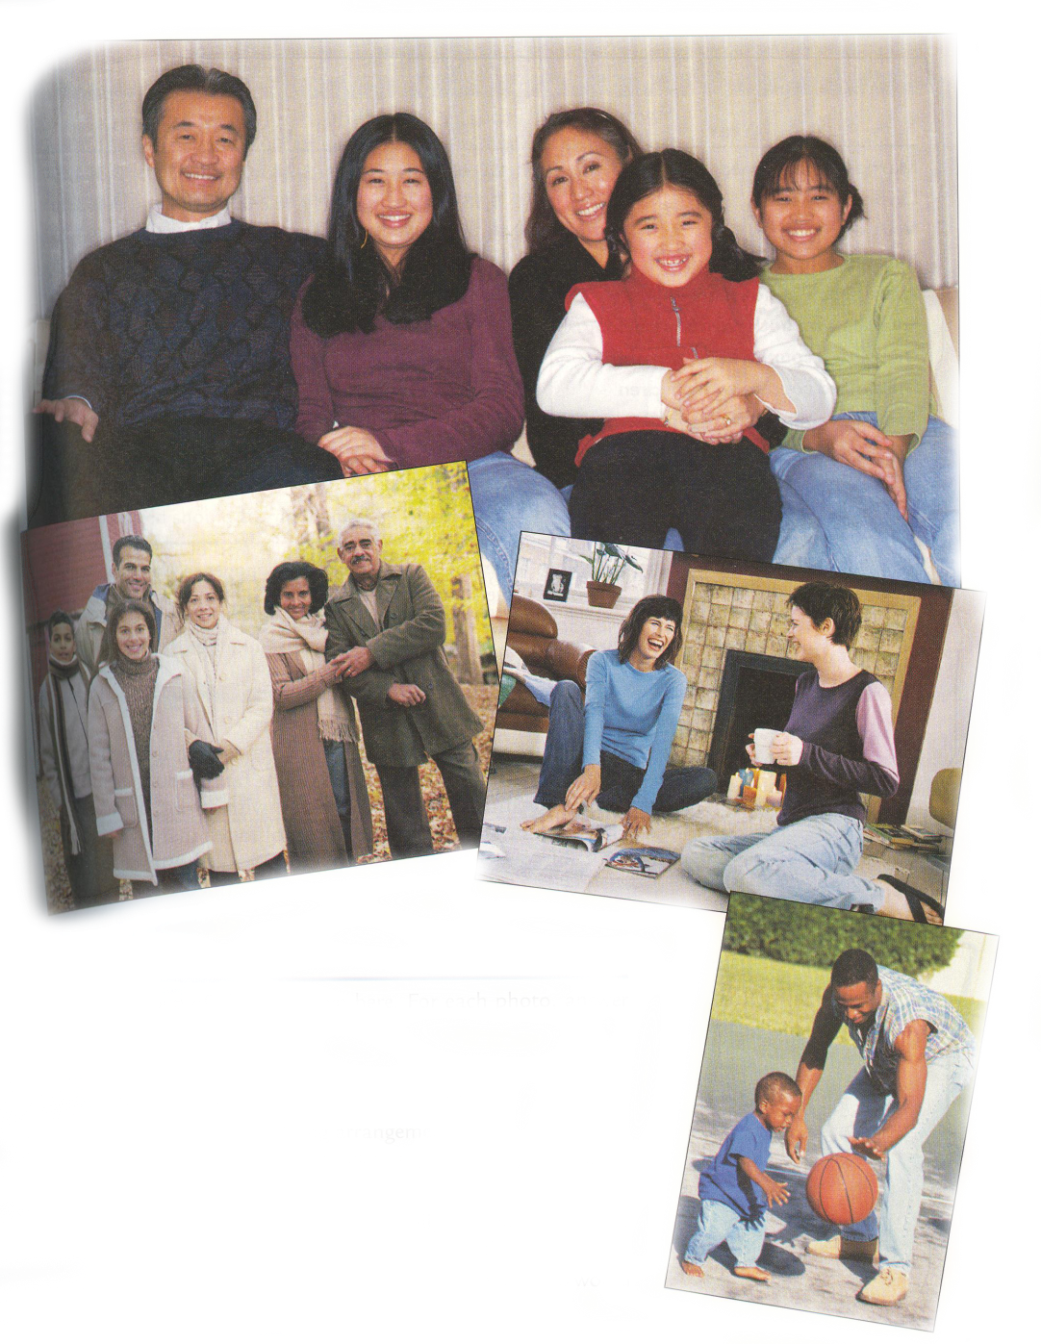
Problem 30.2
For each photo, answer the following…
Is this a family? Why or why not?
Is this living arrangement common
where you live?
How does the law affect this living
arrangement
What are the characteristics of a family? How
would you answer differently depending on whether they have children?
Do you believe there is such a thing as an “ideal family? Who would
be part of such a family? Is this a common arrangement?

Slide 10
Changes in American families

Slide 11
Unmarried couples

Slide 12
Family law…
Anti-miscegenation laws: some states still had them in place in the 1960s
Prohibits marriage between persons of different races
1967 Loving v. Virginia
S.C. decided against Virginia unconstitutionally prohibiting interracial marriage
Canada has granted same-sex couples the right to marry (est. 2003)

Slide 13
GAYS
Vermont Supreme court passes legislation, after deciding that denying gays to marry violated the state’s constitution.
The bill authorized “civil unions”
Not the same as legal marriage, offer same-sex couples similar protections, responsibilities, and benefits
Defense of Marriage Act (DOMA) passed in 1996: declares that states do not have to recognize the same-sex unions created in other states
As of 2003, at least 37 states versions of DOMA…
legal experts say this issue will come before the S.C.

